Slide 1
New Cinemas, London , UK
Coursera Capstone - Final Project
Bharath

Slide 2
Business Requirement
Analyse the boroughs and neighbourhoods within the Greater London area and identify borough(s) to open a new cinemas which has good return on investment.
Look for boroughs with already has established entertainment venues

Slide 3
Approach
Gather data on boroughs and neighbourhoods with boroughs
Look for entertainment venues in the neighbourhoods
Cluster the venues using unsupervised algorithm, K-Means Clustering

Slide 4
Data
Data | Source
London Neighbourhoods | Wikipedia
Geo Location | Geopy.geocoders Python Lib
Venues in Neighbourhoods | Foursquare APIs

Slide 5
Methodology
Scrape wiki data for Boroughs and Neighbourhoods
Use Geopy Python library to retrieve geo coordinates for the neighbourhood
Use Folium library to generate a visual representation of the data
Determine the optimal K value to be used
Use K-Means clustering unsupervised algorithm to cluster the data
Generate a result dataset with cluster labels added.

Slide 6
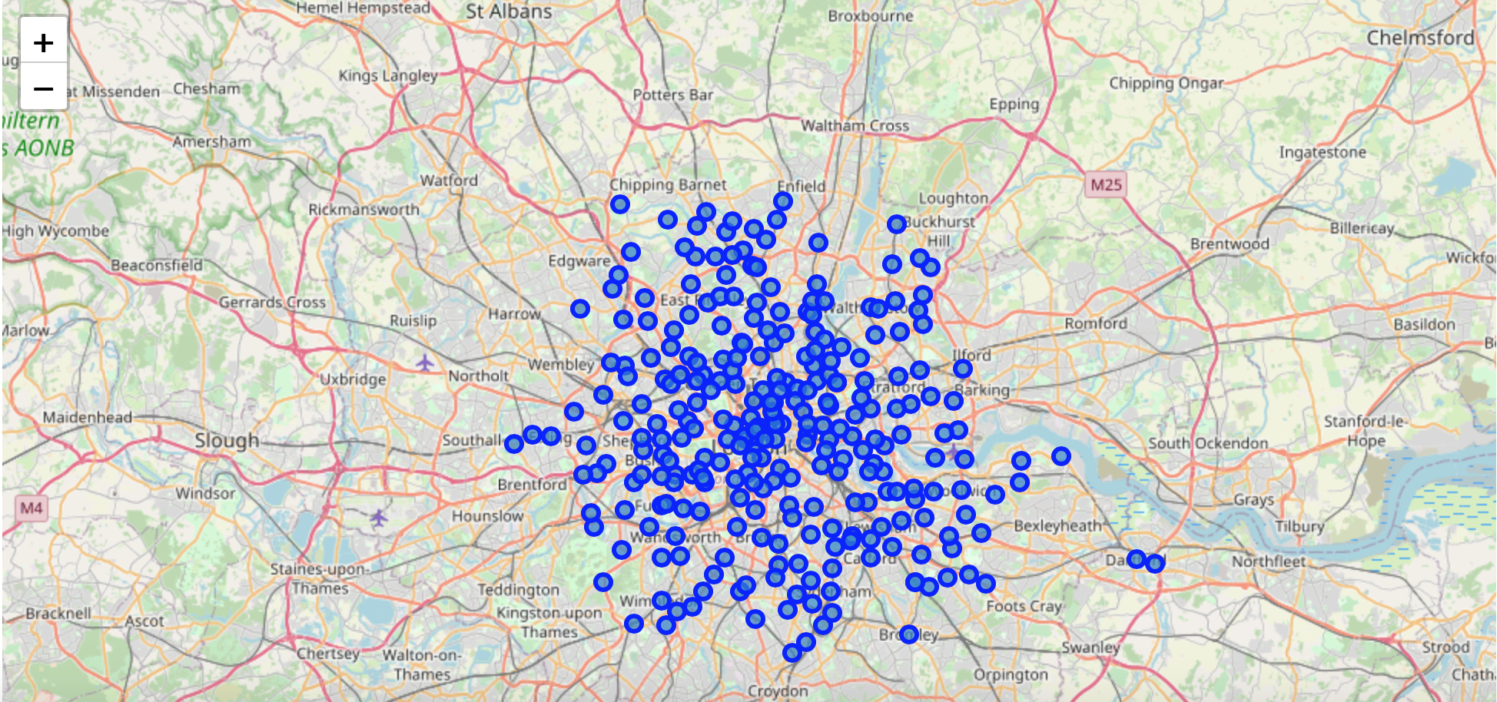
DataSet - Visualised Using Folium

Slide 7
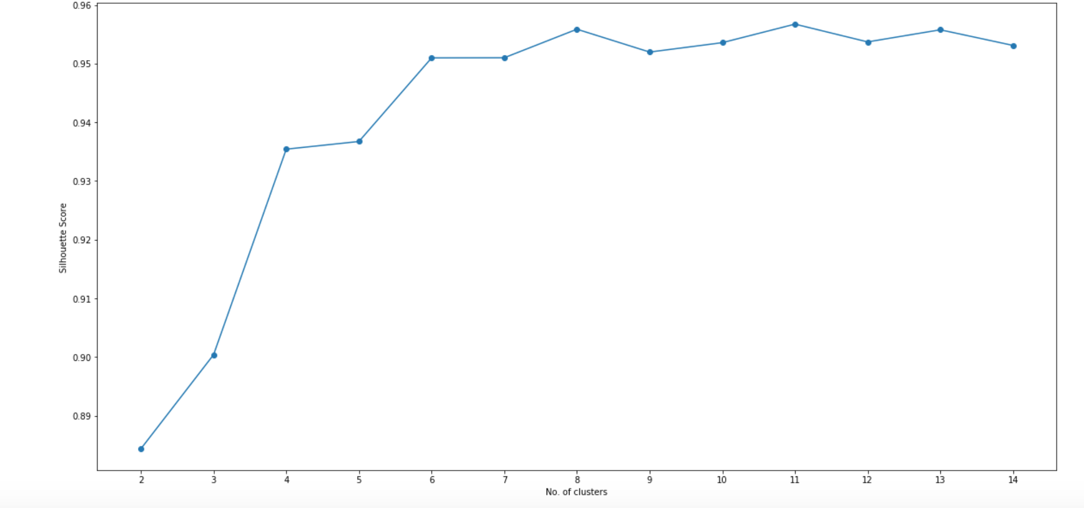
Optimal K - Visualised for Silhouette Score

Slide 8
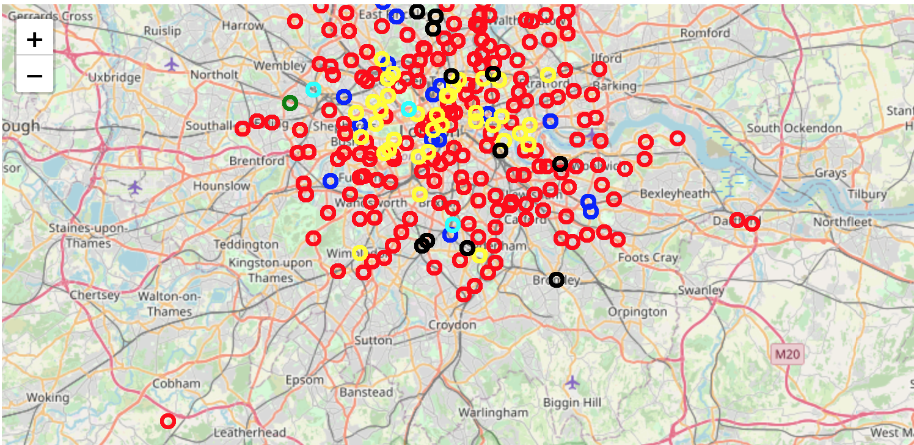
Clustered Dataset - Visualization

Slide 9
Recommendation
The neighbourhoods in cluster 3 are the most preferred locations to open a Cinemas which are concentrated in Tower Hamlets, Hackey, Westminster, Newham, Islington Boroughs.

